Slide 1
Progress Report
2024.3.18
Yida Zhang

Slide 2
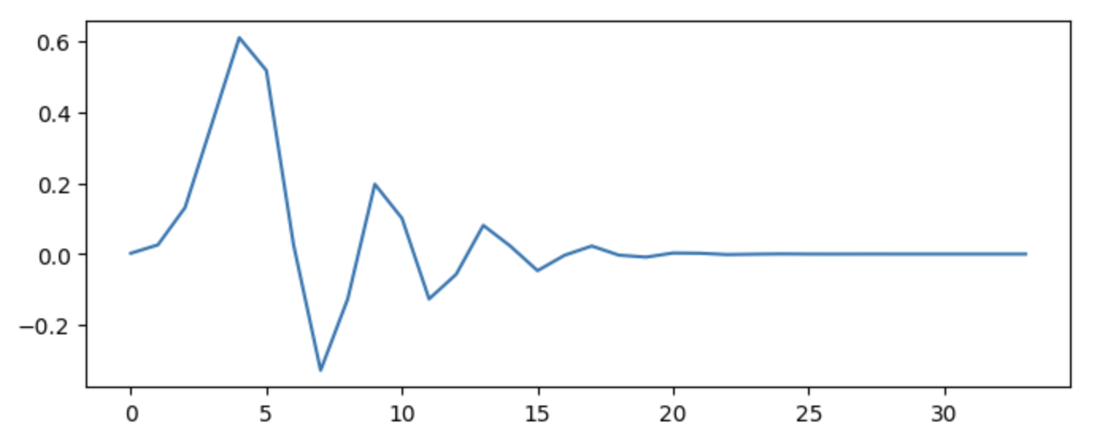
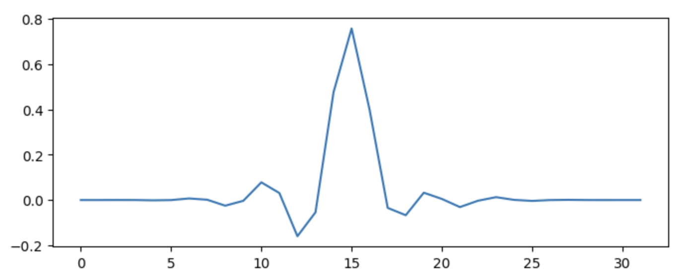
db
sym
Notes:
小波外观差异很大
只需要保证train和test中特征和label的方程一致，不需要考虑震荡的细节ß

Slide 3
Outline
Use larger model to test feature selction layer
Generate D dataset with label shift and test on it
Select among FSFEL features without H, X1, X2, Y1, Y2
Rocket + feature selection layer
Use ML + DSP on four new dataset

Slide 4
Feature Selection with Larger MLP
Dataset: Random number with different distributions
Select 250 in 500: Linear, Polynomial, Exponential
Select 500 in 1000: Linear, Polynomial, Exponential
Model: FS + MLP
Previous: 3 layers with 256 neurons in each layer
Now: 8 layers with 512 neurons in each layer

Slide 5
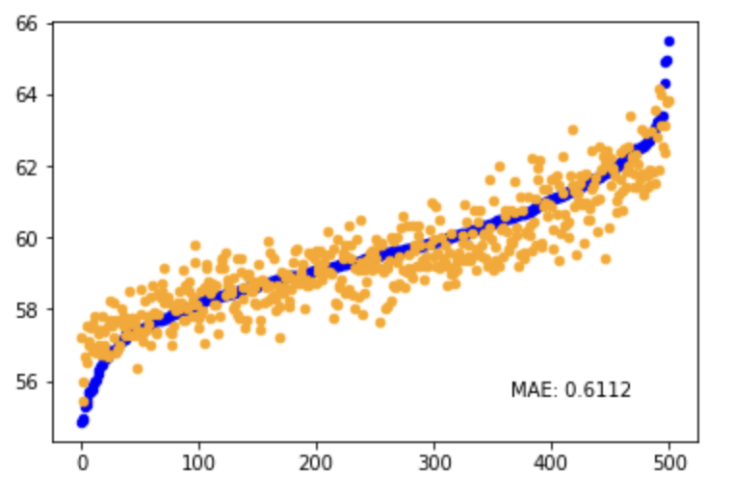
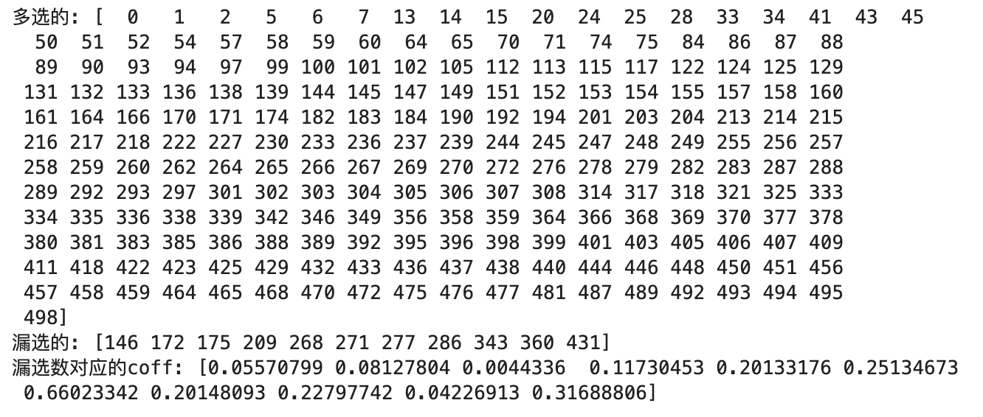
500-250 Linear
Notes:
问题是多选
多选和fs的机制有关
选择层的选择过程是去拟合一个dataset中的方程
选择层并不具有拟合函数的功能，所以拟合的工作全由后续的网络来完成
神经网络拟合会出现一个问题，过拟合，数据越大越容易过拟合
X就xx，x就xx
所以选择层是依附于后续网络的一个模块，两个作用
正则作用取决于lambda，理论上可以做到，lambda对于weight的改变并不是同向的
后续方向：1递归
2增强后面的网络

Slide 6
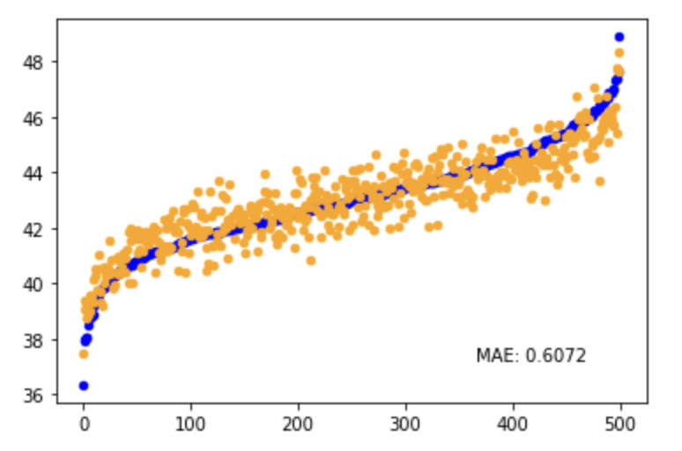
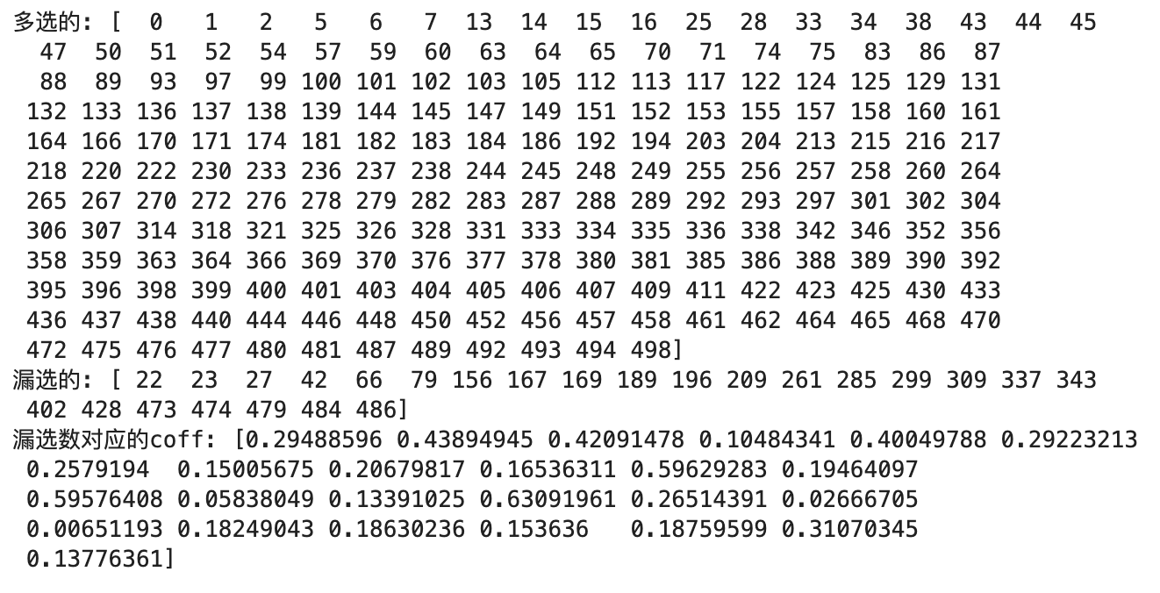
500-250 Polynomial

Slide 7
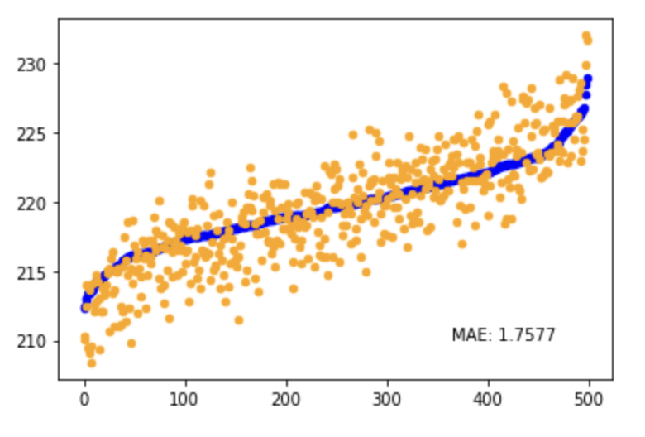
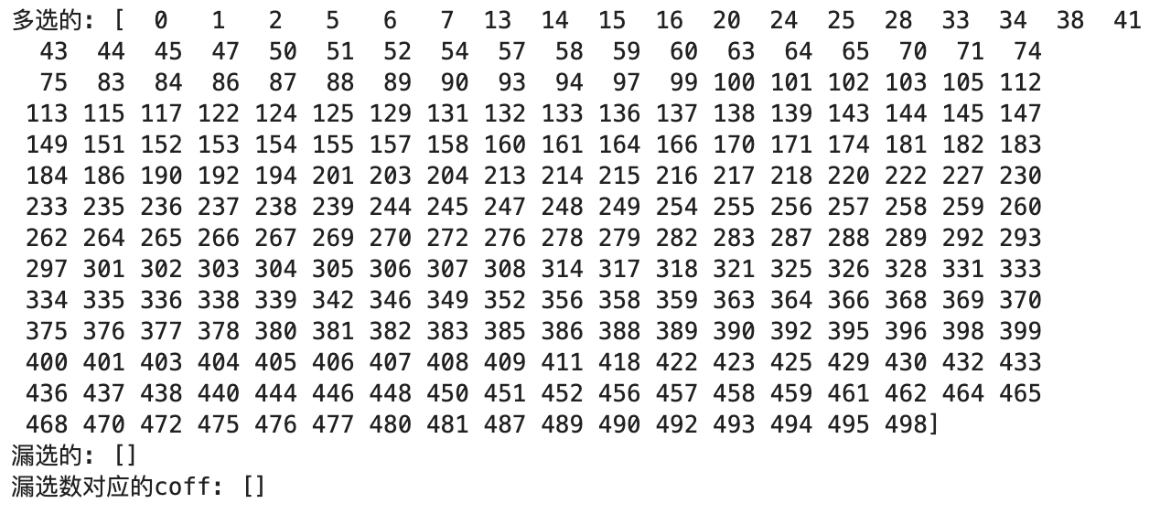
500-250 Exponential

Slide 8
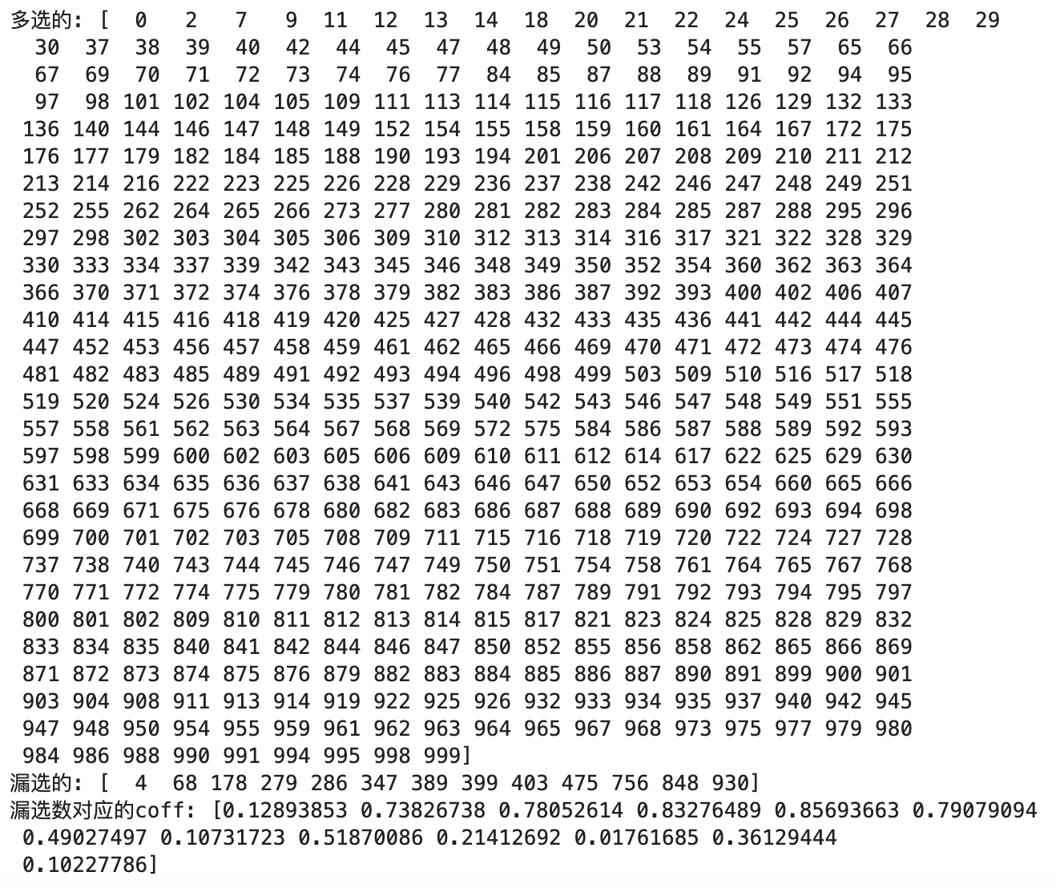
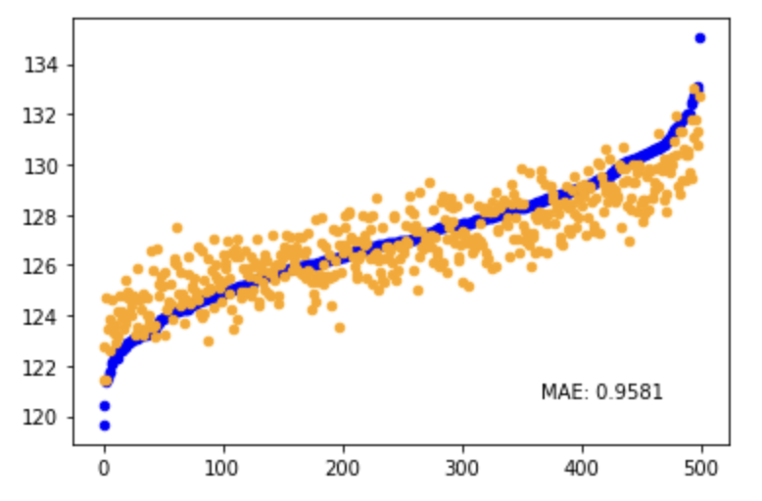
1000-500 Linear

Slide 9
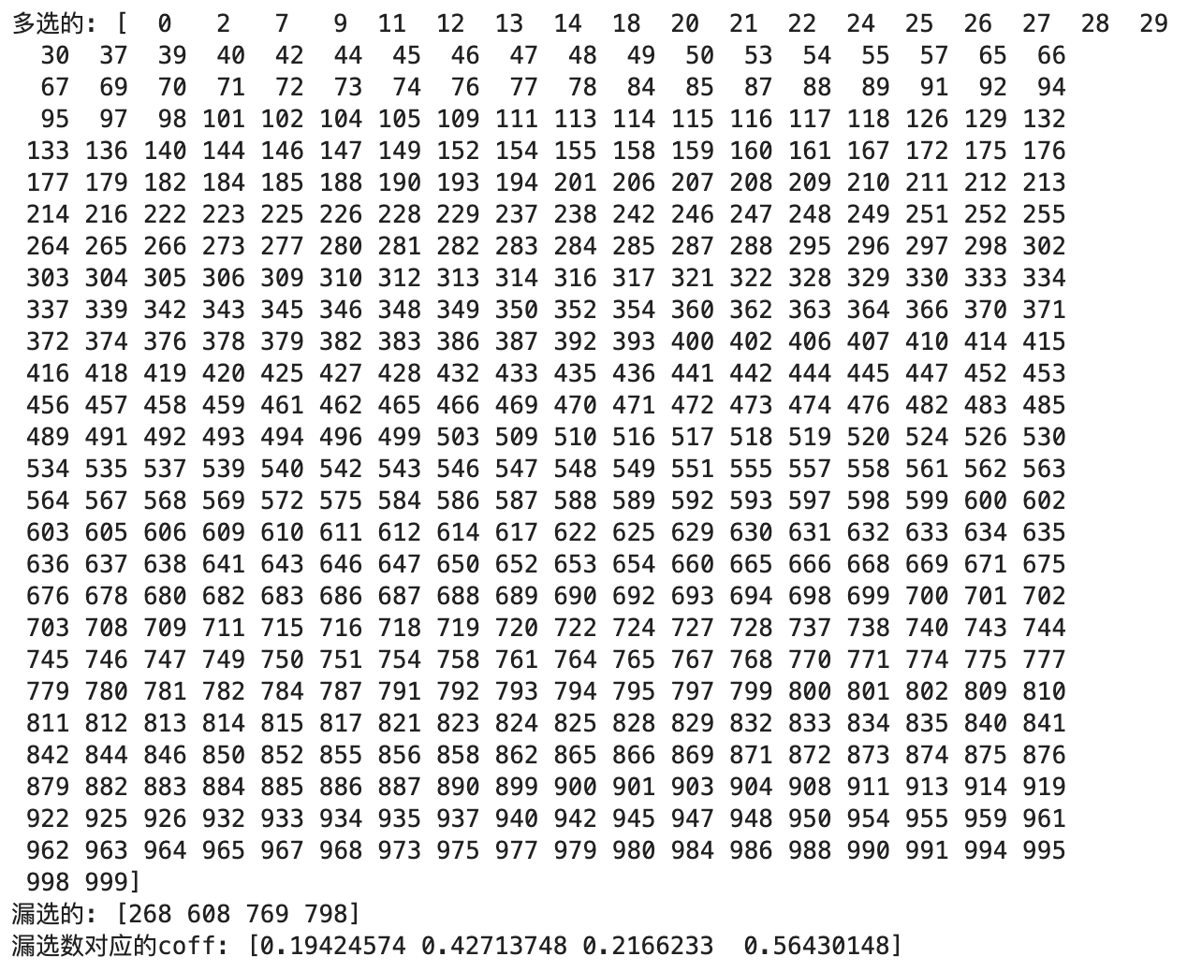
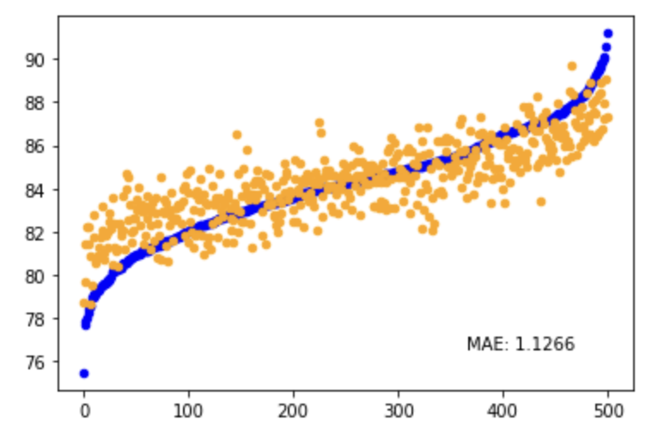
1000-500 Polynomial

Slide 10
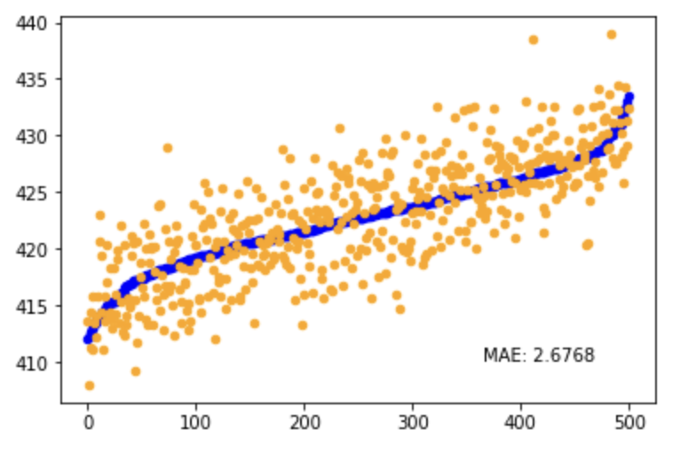
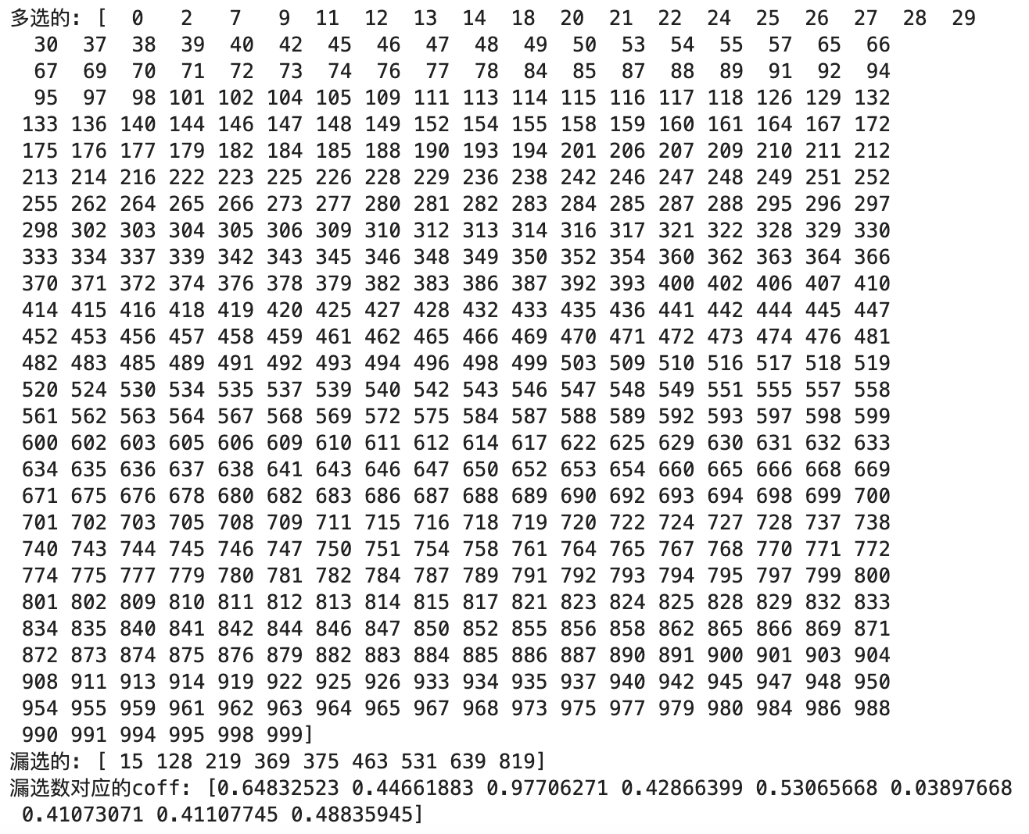
1000-500 Exponential

Slide 11
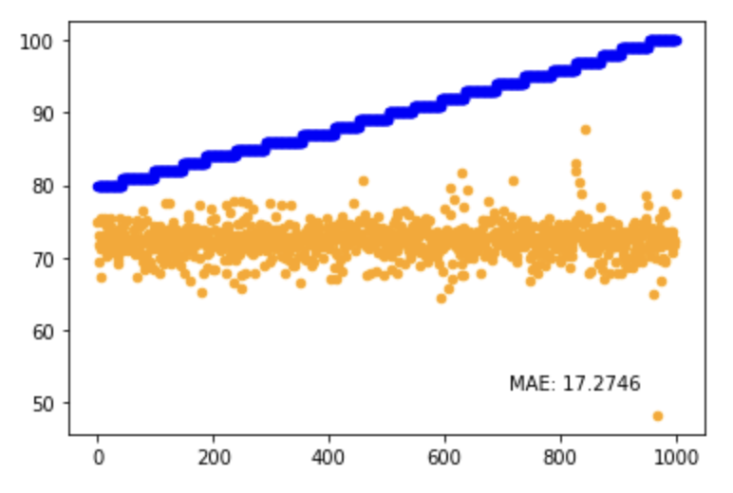
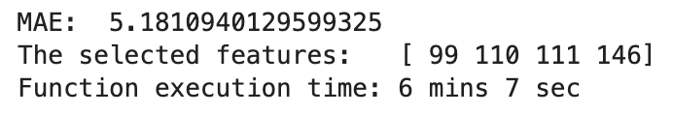
Generate D dataset with label shift and test on it
dataset train: d in [60,80]
dataset test: d in [80,100]

Slide 12
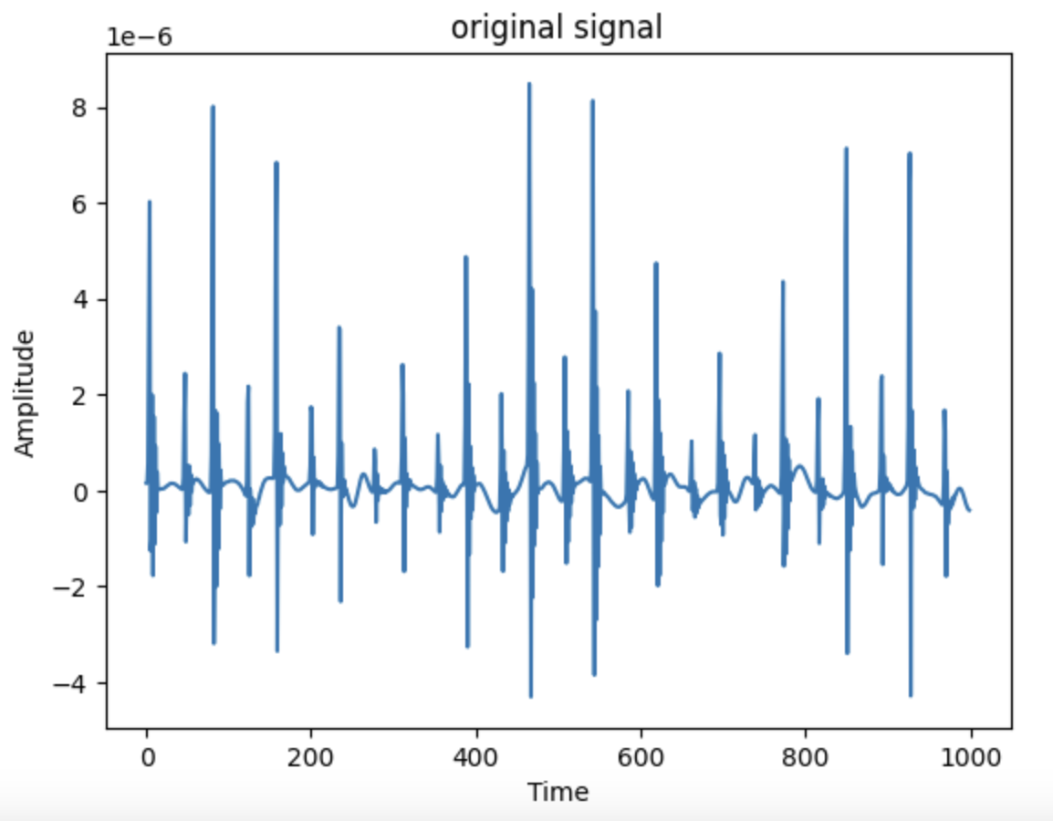
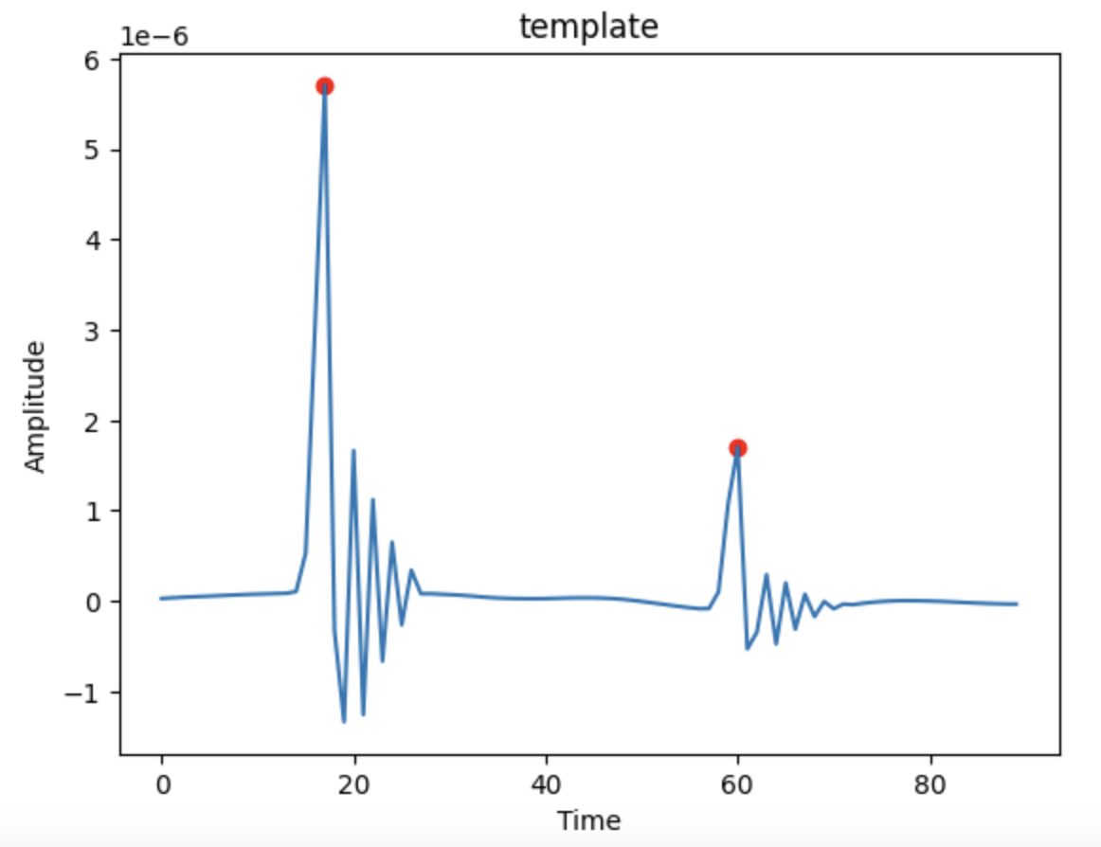
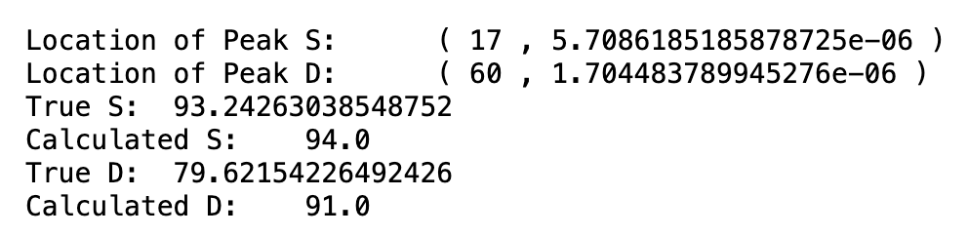
Why the result for D is not good

Slide 13
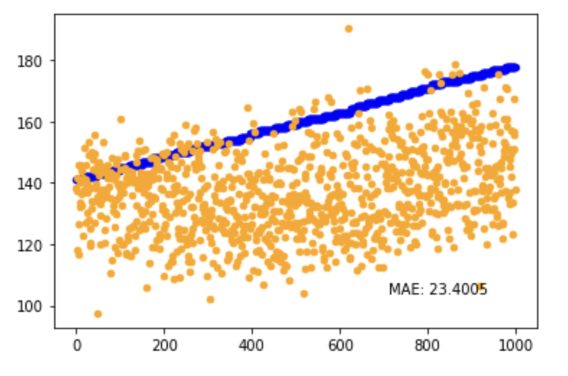
Select among TSFEL features without H, X1, X2, Y1, Y2
Notes:
4 0_ECDF Percentile Count_0
5 0_ECDF Percentile Count_1
19 0_Fundamental frequency
37 0_Histogram_24
72 0_Kurtosis
94 0_MFCC_1
95 0_MFCC_10
98 0_MFCC_13
103 0_MFCC_18
104 0_MFCC_19
105 0_MFCC_2
106 0_MFCC_3
112 0_MFCC_9
115 0_Maximum frequency
124 0_Median frequency
126 0_Negative turning points
132 0_Signal distance
140 0_Spectral positive turning points
141 0_Spectral roll-off
145 0_Spectral spread

Slide 14
Rocket
Dataset: Synthetic SCG dataset (S has label shift, D doesn’t)
Number of Random Kernels: 10000
Each kernel generate 2 features, totally 20000 features
Experiment 1: Use the 20000 features to regress directly (MLP)
Experiment 2: Use Feature Selection Layer to Select first, then regress (FS + MLP)
Notes:
具体解释一下产生了哪两个feature
我认为结果不好的原因：特征抽象层次太低，以及FS处理不了20000个特征

Slide 15
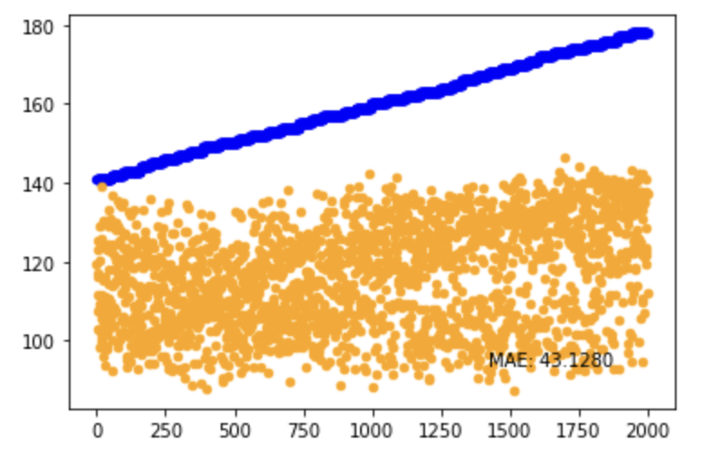
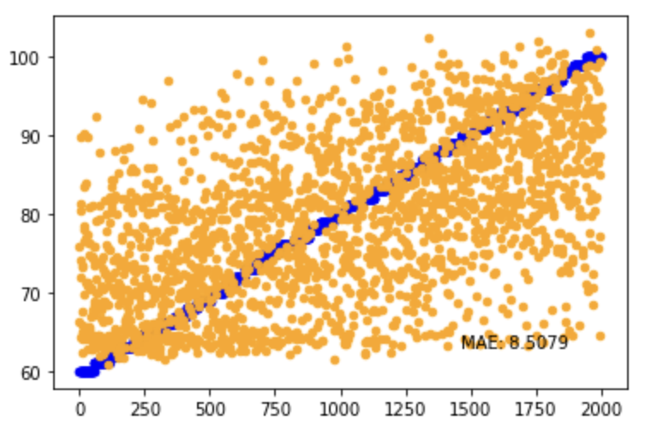
Experiment 1: Use the 20000 features to regress directly
Result for S
Result for D

Slide 16
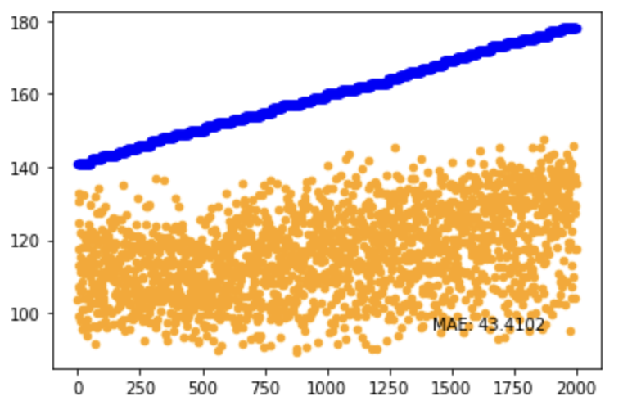
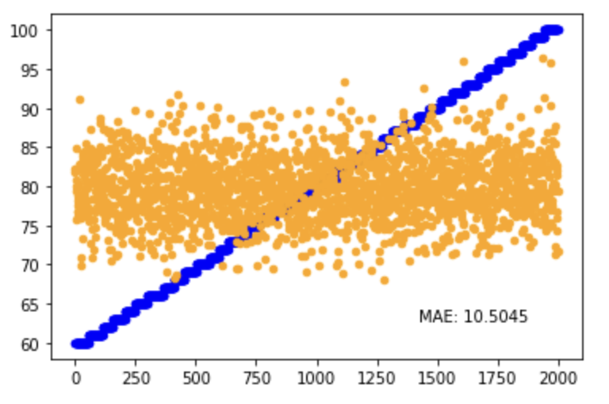
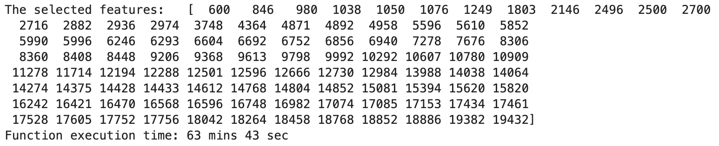
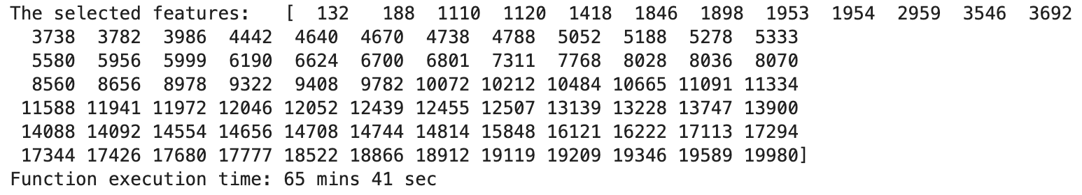
Experiment 2: Select Features then regress
Result for S
Result for D
Notes:
96个特征

Slide 17
set 1: the motherlet of the train and test set is different, and the random noise = 0.1 is added in both set
set 2: the motherlet of the train and test set is different, and the resonance noise = 0.1 is added in both set
set 3: the motherlet of the train and test set is same, and the random noise = 0.1 is added in the train set, while the resonance noise = 0.1 is added in the test set
set 4: the motherlet of the train and test set is different, and the random noise = 0.1 is added in the train set, while the resonance noise = 0.1 is added in the test set

Slide 18
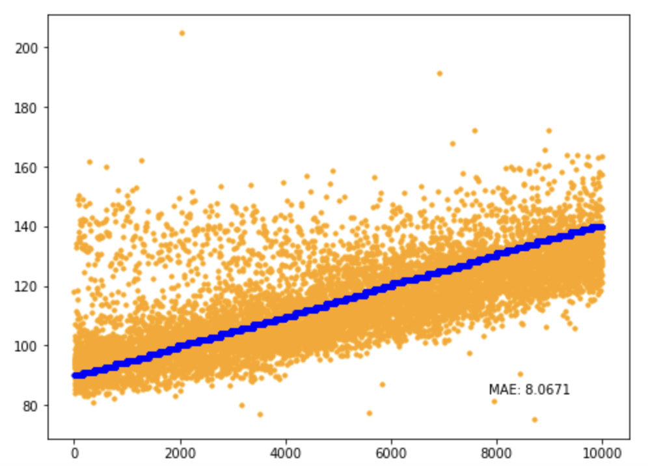
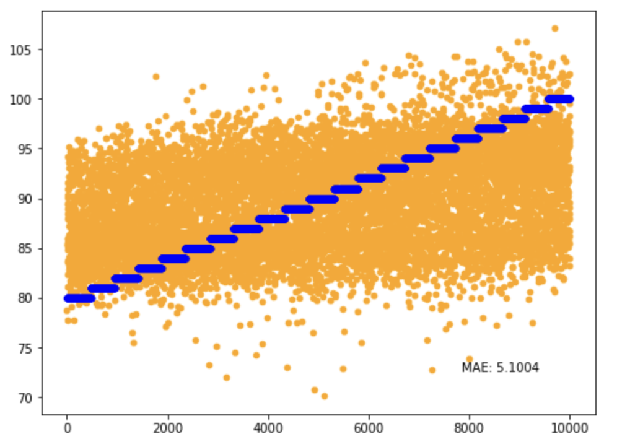
Dataset train: db + 0.1 random noise
Dataset test: sym + 0.1 random noise
Result for S
Result for D

Slide 19
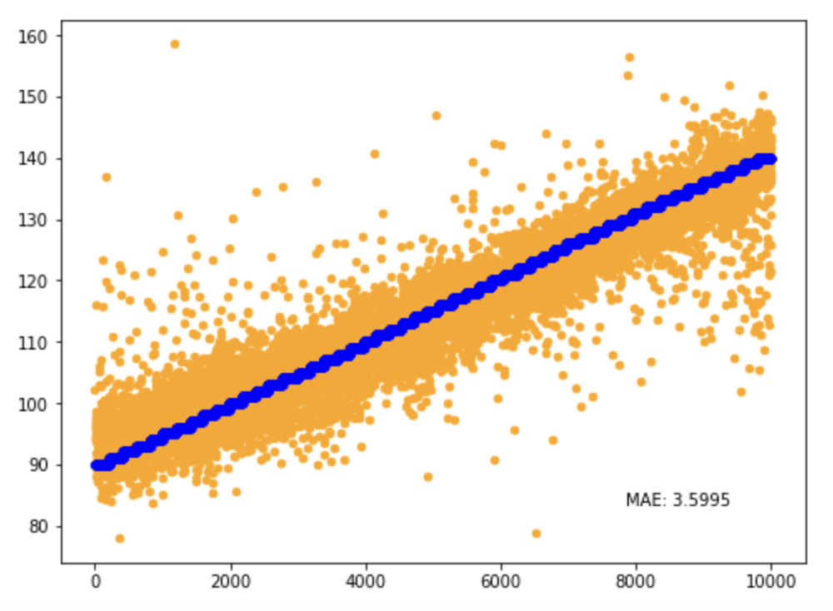
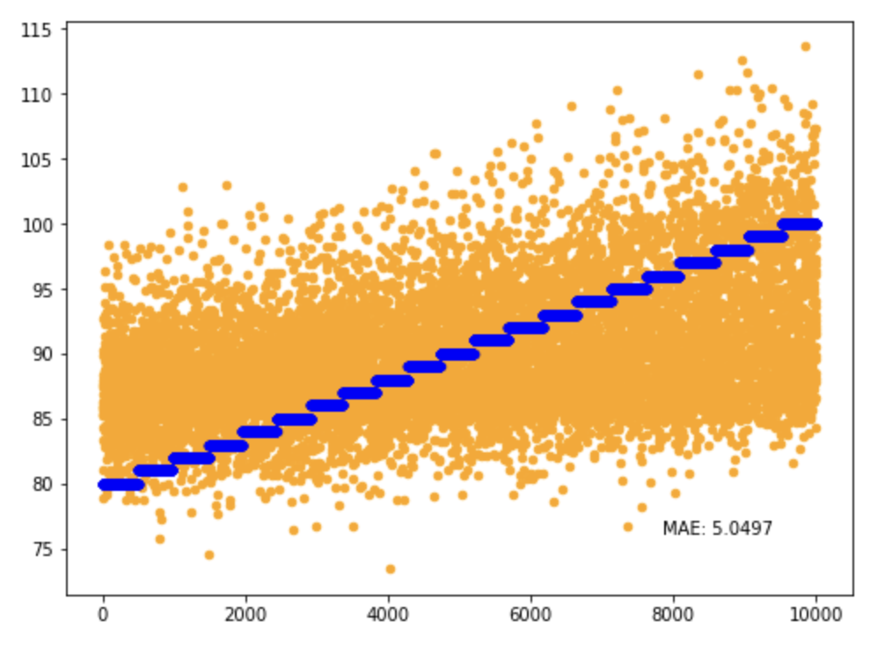
Dataset train: db + 0.1 resonance
Dataset test: sym + 0.1 resonance
Result for S
Result for D

Slide 20
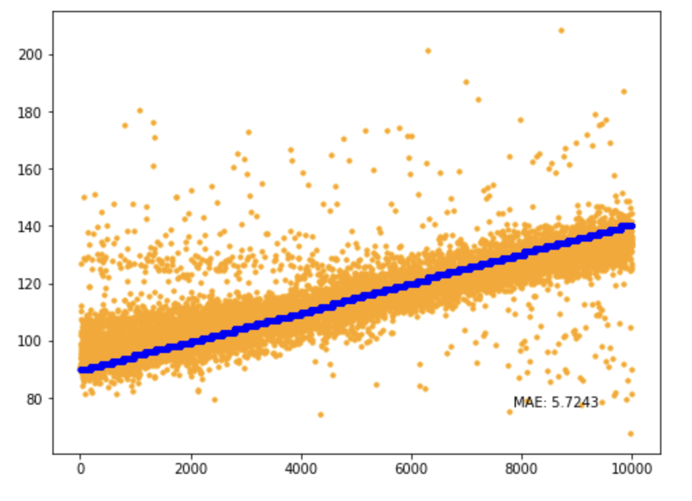
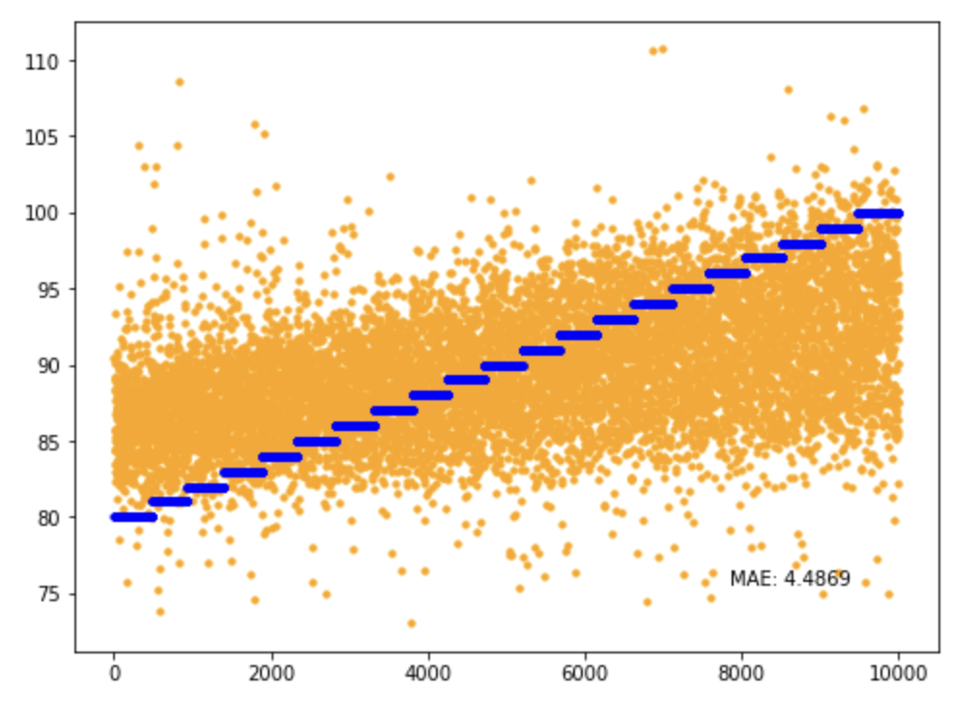
Dataset train: db + 0.1 random noise
Dataset test: db + 0.1 resonance
Result for S
Result for D

Slide 21
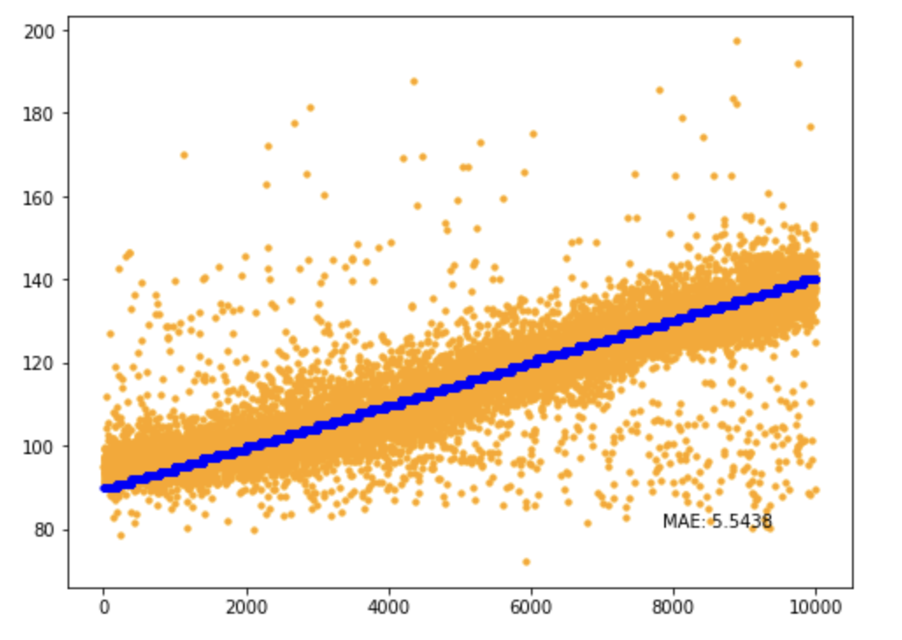
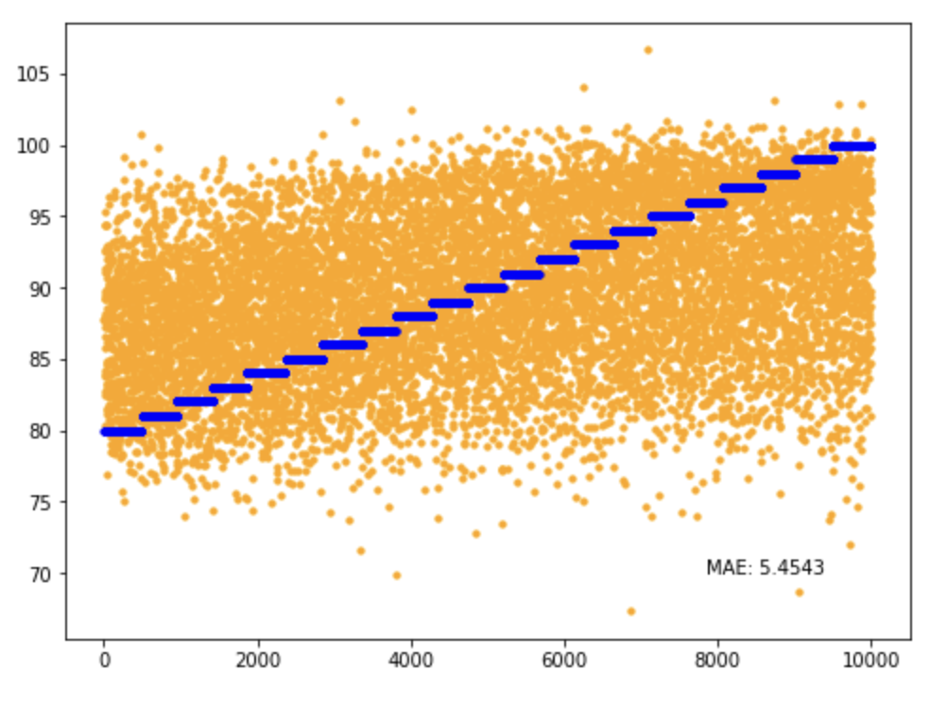
Dataset train: db + 0.1 random noise
Dataset test: sym + 0.1 resonance
Result for S
Result for D

